Slide 1





SOUL OF BANGLADESH

Slide 2

OUR TEAM
Labonno Rahan Oishy (2254901107)
Nasrat Jahan (2254901061)
Rabeya Islam Rima (2254901055)
Ameer Sohail(2254901011)
Sunehra Tabassum (2254901047)

Slide 3
REQUIREMENTS

Slide 4
FEATURES
Labonno Rahman Oishy | Admin Panel, Sundorbon
Nasrat Jahan | Education, Culture
Sunehra Tabassum | Transportation, Hill and Mountain
Ameer Sohail | Sports, Haritage
Rabeya Islam Rima | River and War History

Slide 5
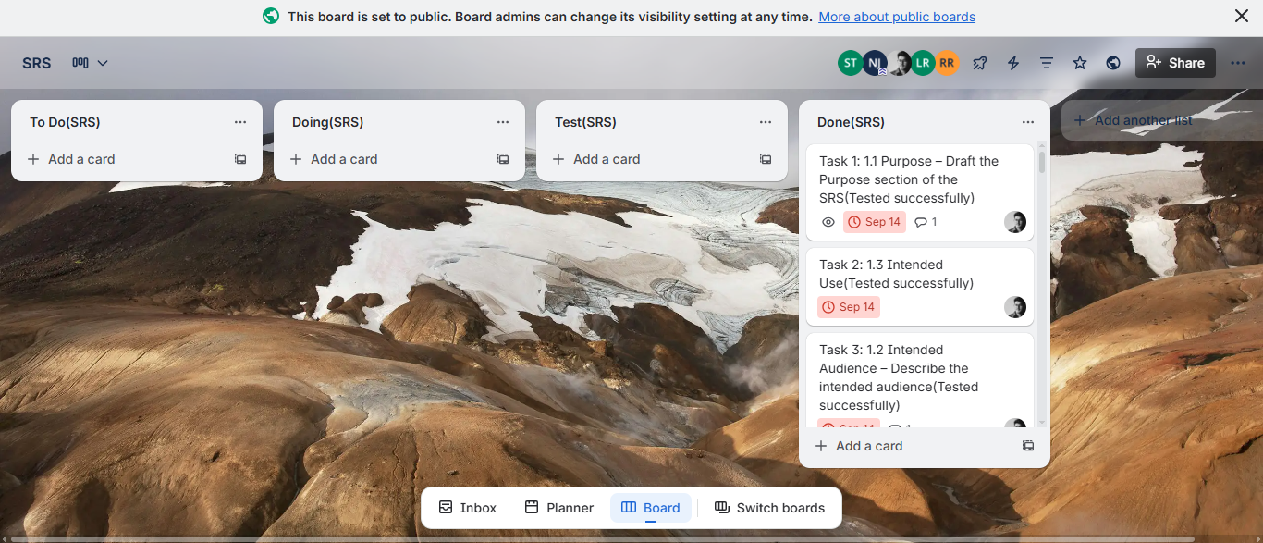
TRELLO ACTIVITY ON SRS

Slide 6
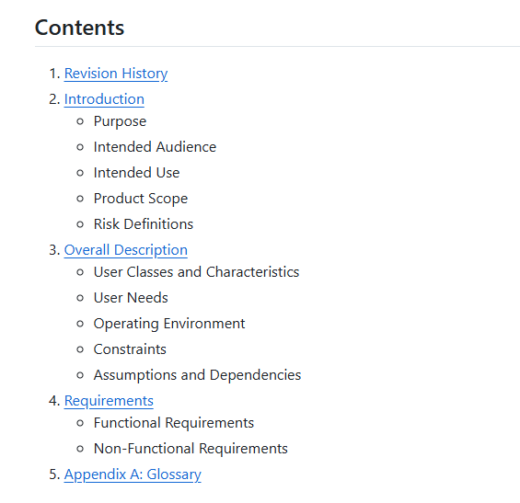
SRS CONTENT IN WIKI

Slide 7
CODING STANDARDS

Slide 8
CODING STANDARDS
1. HTML STANDARDS:
Semantic Structure: Use semantic tags like <header>, <sectiON>, AND <FOOTER> FOR BETTER READABILITY AND ACCESSIBILITY.
CLASS NAMING: USE KEBAB-CASE FOR CSS CLASSES (E.G., MAIN-HEADER).
ID NAMING: USE CAMELCASE FOR UNIQUE ELEMENT IDENTIFIERS, TYPICALLY FOR JAVASCRIPT HOOKS (E.G., USERPROFILE).
ATTRIBUTES: INCLUDE ALT FOR IMAGES AND DESCRIPTIVE NAMES FOR FORM INPUTS.
ACCESSIBILITY: USE ARIA ATTRIBUTES LIKE ROLE AND ARIA-LABEL WHERE NECESSARY.
FORMS: USE APPROPRIATE INPUT TYPES (E.G., EMAIL, PASSWORD), REQUIRED AND PATTERN FOR CLIENT-SIDE VALIDATION.
META TAGS: INCLUDE PROPER CHARSET AND VIEWPORT IN <HEAD> FOR RESPONSIVE DESIGN.

Slide 9
CODING STANDARDS
2. CSS STANDARDS:
Classes: Use kebab-case (e.g., infO-BOX, READ-MORE-BTN).
IDS: USE CAMELCASE FOR UNIQUE ELEMENTS (E.G., MAINNAV).
INDENTATION: USE 2 SPACES FOR INDENTATION.
INLINE STYLES: AVOID INLINE STYLES; USE CLASSES FOR STYLING.
CSS VARIABLES: USE FOR COLORS, FONTS, AND SPACING TO MAKE THE CODE MORE MAINTAINABLE.
RESPONSIVE DESIGN: USE MOBILE-FIRST MEDIA QUERIES FOR RESPONSIVE STYLING.
COMMENTING: ADD COMMENTS FOR CLARITY AND MAINTAINABILITY.
3. JAVASCRIPT STANDARDS:
VARIABLES AND FUNCTIONS: USE CAMELCASE (E.G., LOGINUSER(), ADDTOCART()).
CONSTANTS: USE UPPERCASE (E.G., MAX_COUNT).
ES6+ FEATURES: USE LET, CONST, ARROW FUNCTIONS, TEMPLATE LITERALS.
AVOID GLOBAL SCOPE POLLUTION: ENCAPSULATE LOGIC IN WINDOW.ONLOAD OR IIFE (IMMEDIATELY INVOKED FUNCTION EXPRESSIONS).
EVENT DELEGATION: PREFER EVENT DELEGATION FOR HANDLING MULTIPLE ELEMENTS.
ERROR HANDLING: USE TRY-CATCH BLOCKS FOR ERROR HANDLING.
MODULAR JAVASCRIPT: USE SEPARATE FILES FOR DIFFERENT COMPONENTS

Slide 10
CODING STANDARDS
4. PHP STANDARDS:
Variables: Use snake_case (e.g., $user_id, $total_products).
Functions: Use camelCase (e.g., loginUser(), addToCart()).
Classes: Use PascalCase (e.g., UserController).
Files: Use lowercase with underscores (e.g., connect.php, userheader.php).
Strict Typing: Enable strict types with declare(strict_types=1);.
Includes: Use require_once() for critical includes.
Input Validation: Use filter_input() for input validation and sanitization.
Error Reporting: Different error reporting settings for development and production environments.
DATABASE STANDARDS:
TABLE AND COLUMN NAMES: USE SNAKE_CASE FOR NAMING (E.G., USER_PROFILE).
PRIMARY KEYS: USE AUTO-INCREMENT INTEGERS FOR PRIMARY KEYS.
SQL KEYWORDS: USE UPPERCASE FOR SQL KEYWORDS (E.G., SELECT, INSERT), AND LOWERCASE FOR TABLE AND COLUMN NAMES.
FOREIGN KEYS: USE FOREIGN KEYS TO DEFINE RELATIONSHIPS BETWEEN TABLES.
INDEXES: INDEX FREQUENTLY USED COLUMNS FOR PERFORMANCE OPTIMIZATION.
CHARACTER SET: USE UTF8MB4 FOR FULL UNICODE SUPPORT.
AUTO TIMESTAMPS: INCLUDE CREATED_AT AND UPDATED_AT TIMESTAMPS IN TABLES.
PREPARED STATEMENTS: ALWAYS USE PREPARED STATEMENTS FOR DATABASE QUERIES.

Slide 11
CODING STANDARDS
6. SECURITY PRACTICES:
Input Validation: Use htmlspecialchars(), strip_tags(), and filter_input() to sanitize inputs.
SQL Injection Prevention: Use prepared statements and parameterized queries.
XSS Prevention: Escape dynamic content using htmlspecialchars().
CSRF Protection: Include and verify CSRF tokens in critical forms.
Password Security: Hash passwords using password_hash() (BCRYPT) and verify with password_verify().
Session Management: Use session_start(), regenerate session IDs on login, and destroy sessions on logout.
Access Control: Implement role-based access controls for sensitive pages (e.g., admin dashboards).
HTTPS: Always use HTTPS for encrypting data.
Error Handling: Avoid exposing detailed error messages to the user; log them securely.

Slide 12
CODING STANDARDS
7. PROJECT STRUCTURE AND VERSION CONTROL:
Folder Structure:
/assets for static resources (e.g., CSS, JS, images).
/components for reusable components (e.g., header.php, footer.php).
/pages for different pages (e.g., home.php, cart.php).
/config for configuration files (e.g., config.php).
/vendor for third-party libraries.
index.php for the main entry file.
Version Control:
Git branching: Use main for production, dev for development, and feature-specific branches (e.g., feature/xyz).
Use meaningful commit messages like feat, fix, docs, refactor, and chore.
Follow the GitHub workflow for pull requests and code reviews.

Slide 13


DOCUMENTATION

Slide 14
DESIGN

Slide 15
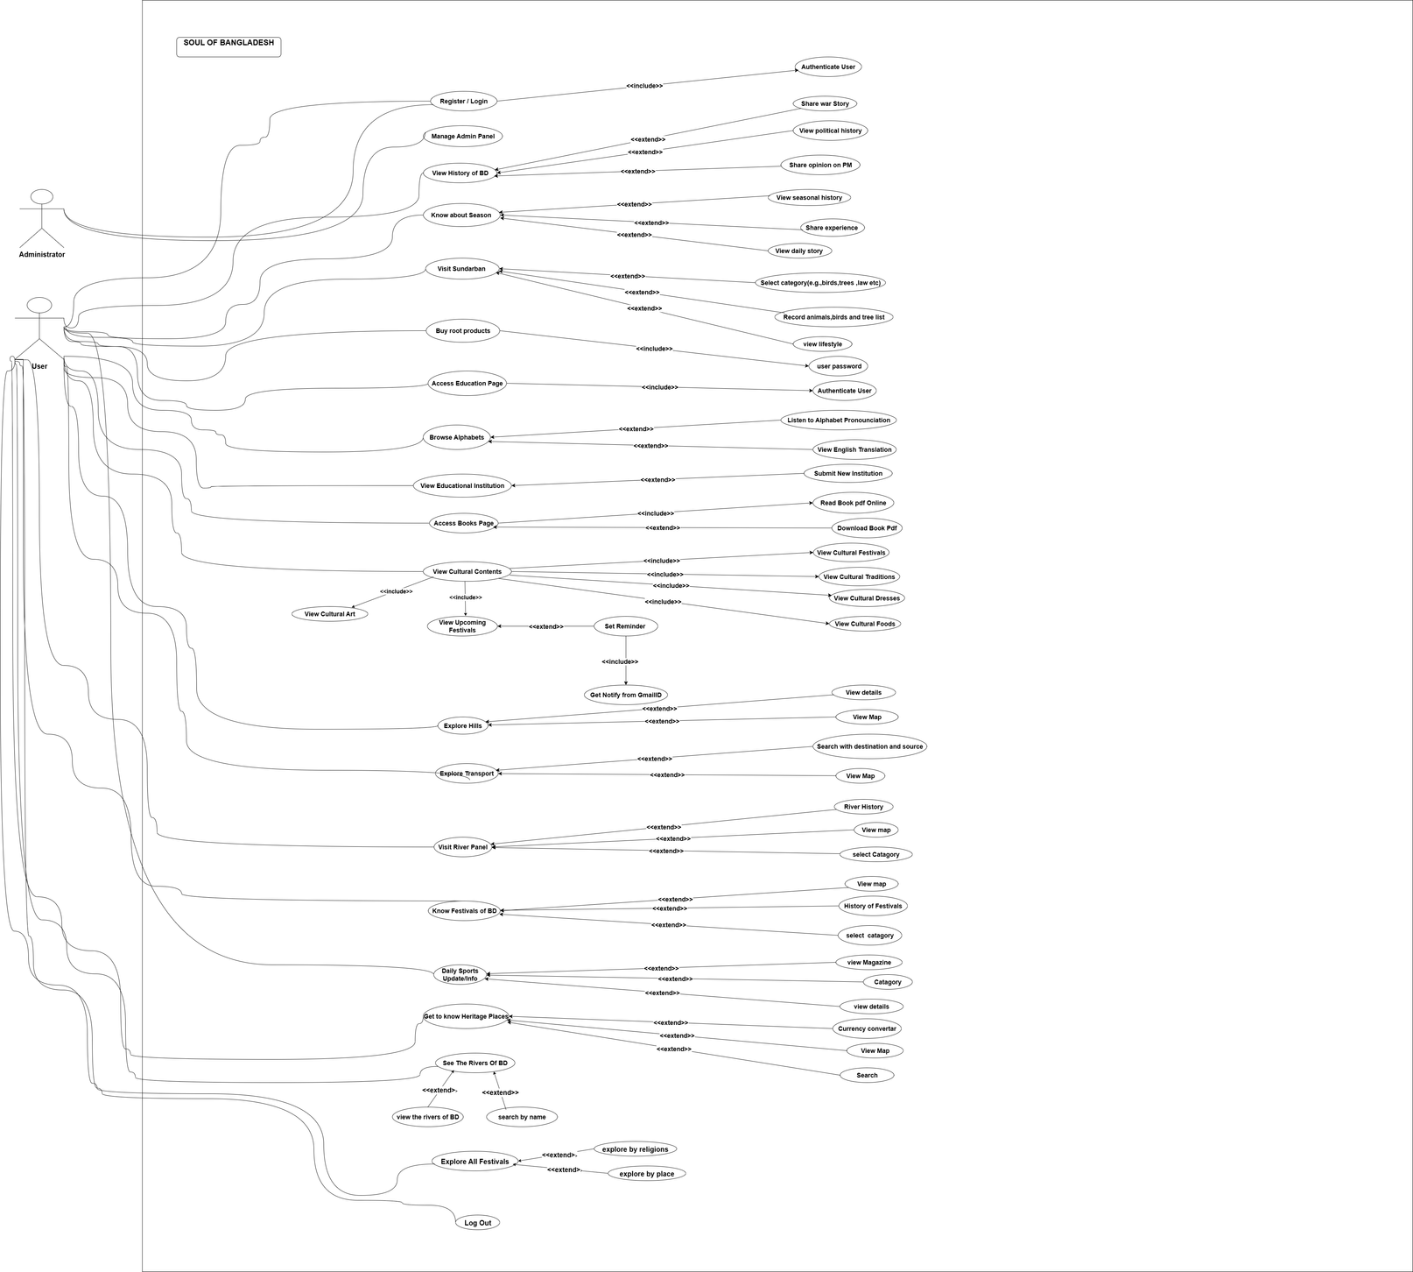
USE CASE DIAGRAM

Slide 16
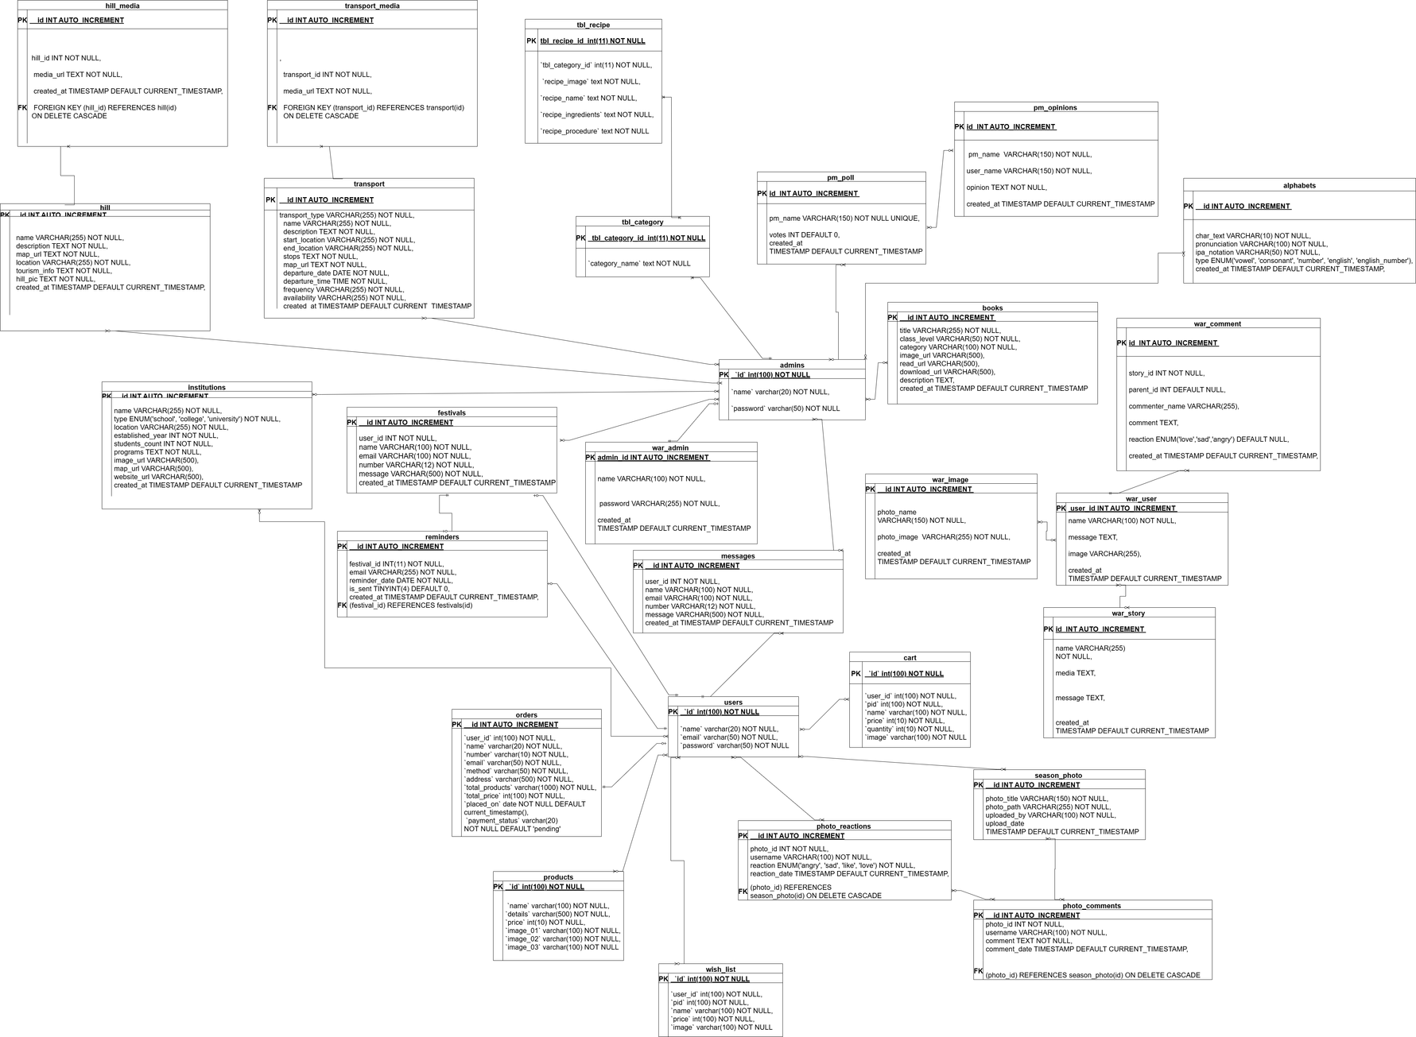
SCHEMA DIAGRAM

Slide 17
NIELSEN’S HEURISTICS
Nielsen’s heuristics are general principles, meaning that they do not determine specific usability rules. Instead, the heuristics are general rules of thumb you can follow to help create more accessible, user-friendly, and intuitive digital products.
Visibility of system status;
Match between system and the real world;
User control and freedom;
Consistency and standards;
Error prevention;
Recognition rather than recall;
Flexibility and efficiency of use;
Aesthetic and minimalist design;
Help users recognize, diagnose, and recover from errors;
Help and documentation.

Slide 18



UI OF THE PROJECT

Slide 19
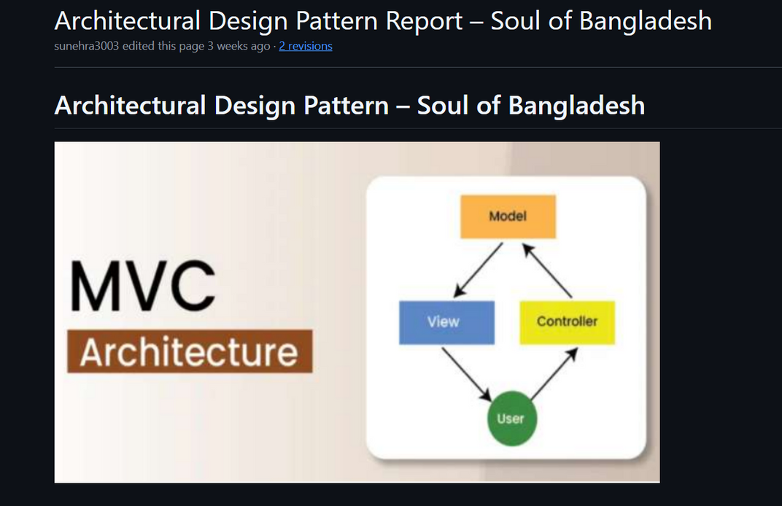
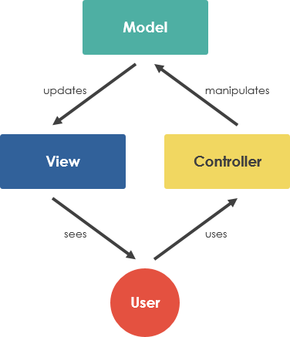
ARCHITECTURE PATTURN MVC

Slide 20
ARCHITECTURE PATTURN MVC
Model | Handles data logic, database queries, and business rules
View | Manages UI/UX and displays content to users (HTML, CSS, Tailwind, JS)
Controller | Works as the bridge between Model and View, handles user requests and system responses

Slide 21
ARCHITECTURE PATTURN MVC
CLEAN SEPARATION OF LOGIC: No mixing of UI code with database or processing logic. Makes code neat and pro-level.
Scalability: New features like language learning, seasonal modules, voting, or chatbot integration can be added without breaking existing code.
Easy maintenance: Bugs are easier to track because each part (UI, logic, DB) is isolated.
Reusability: Components like database queries, controllers, and UI templates can be reused across multiple sections of the website.
Faster collaboration: Since code is mODULAR, MULTIPLE DEVELOPERS CAN WORK SIMULTANEOUSLY ON DIFFERENT PARTS—UI, LOGIC, AND DATABASE—WITHOUT CONFLICTS.
BETTER PERFORMANCE & SECURITY: USER INPUTS ARE HANDLED IN CONTROLLERS, SANITIZED IN MODELS, AND ONLY SAFE OUTPUTS REACH THE VIEWS, REDUCING SECURITY RISKS LIKE SQL INJECTION AND LOGIC LOOPHOLES.

Slide 22
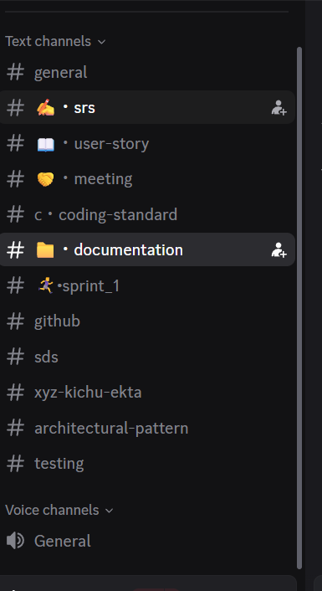
DISCORD CHANNELS FOR PROJECT

Slide 23
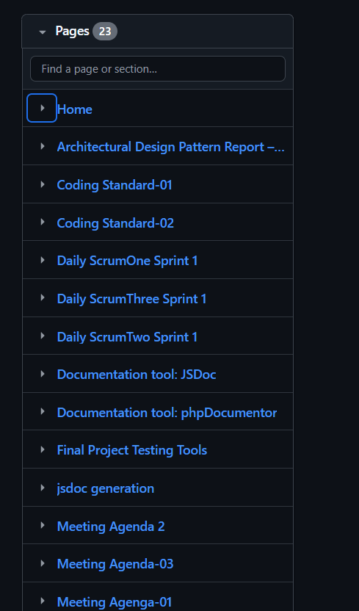
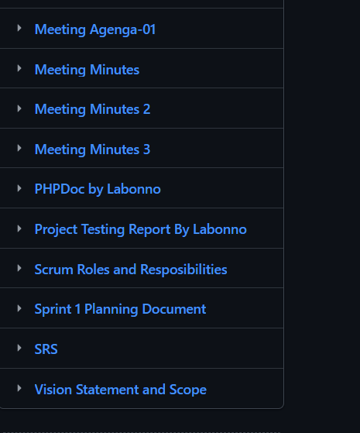
THE PAGES OF PROJECT IN GITHUB

Slide 24
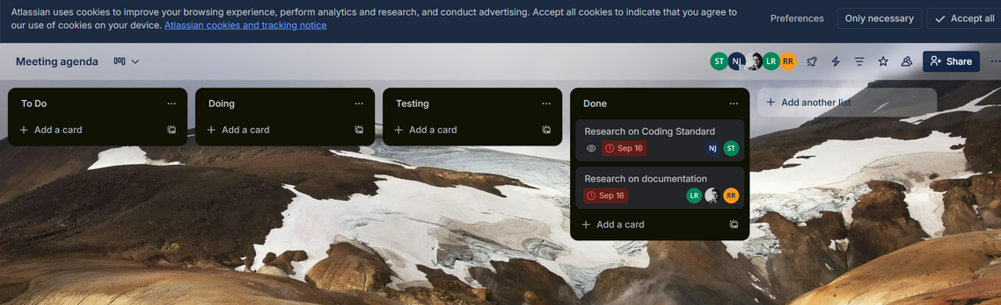
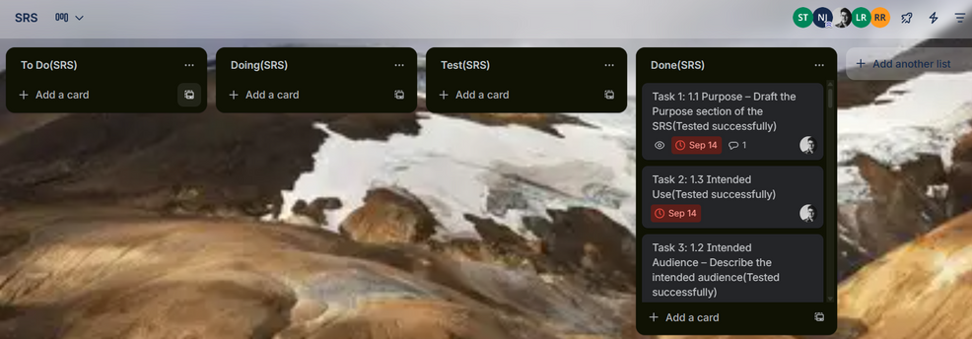
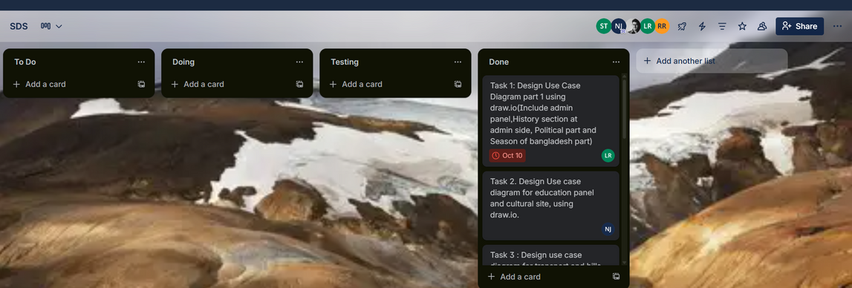
TRELLO TASK CARD FOR PROJECT
Meeting Agenda
SRS
SDS

Slide 25
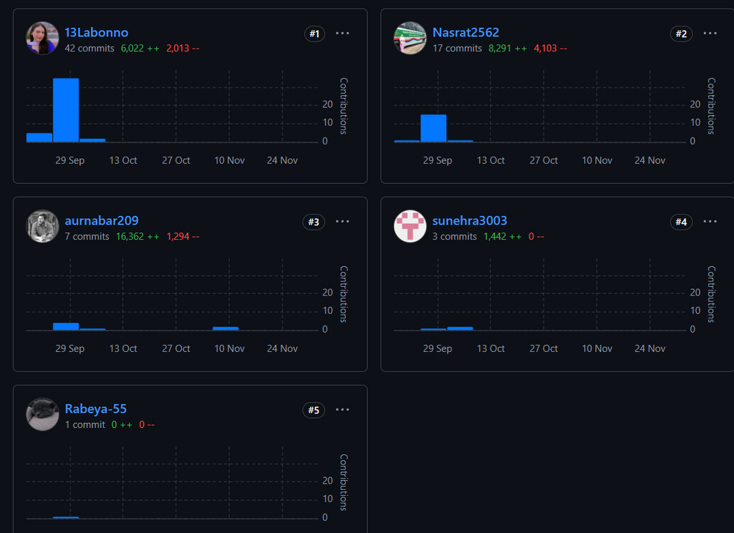
THE CONTRIBUTORS OF PROJECT

Slide 26
THANK
YOU

